Slide 1
STOCK MARKET FORECASTING
TATA MOTORS LTD
Group Members:
1.Mahesh Renkuntla
2.Rahul Patel
3.Shreyansh Gaurkar
4.Pranali Jagtap
5.Shubham Kapadne
Mentor:
Mr.Ritesh Maury

Slide 2


Objective
Stock market prediction is to determine the future value of company stock or other financial instruments traded on an exchange. The successful prediction of a stock’s future price could yield a significant profit. In this application, we used the ARIMA model to predict the next single day as well as next 10 days closing stock price using the past 10 years stock prices.
We also have imported few forecasting and visualization libraries.

Slide 3

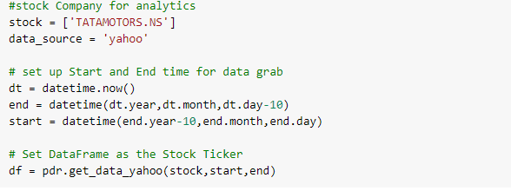
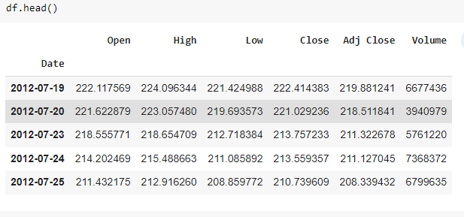
Dataset Source: yfinance
Collected TATA MOTORS data of 10 years.
EXTRACTED DATA

Slide 4
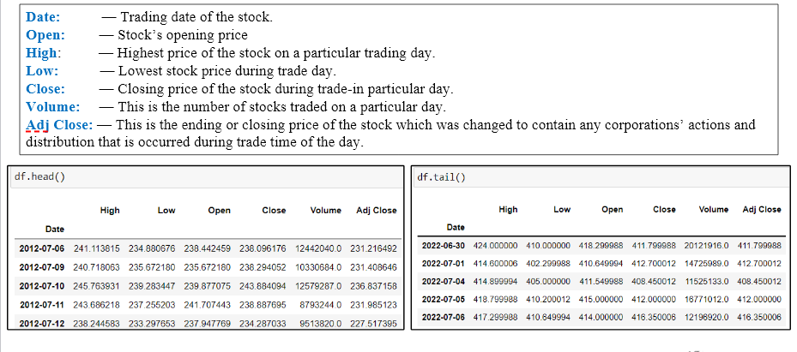
Description of Data

Slide 5

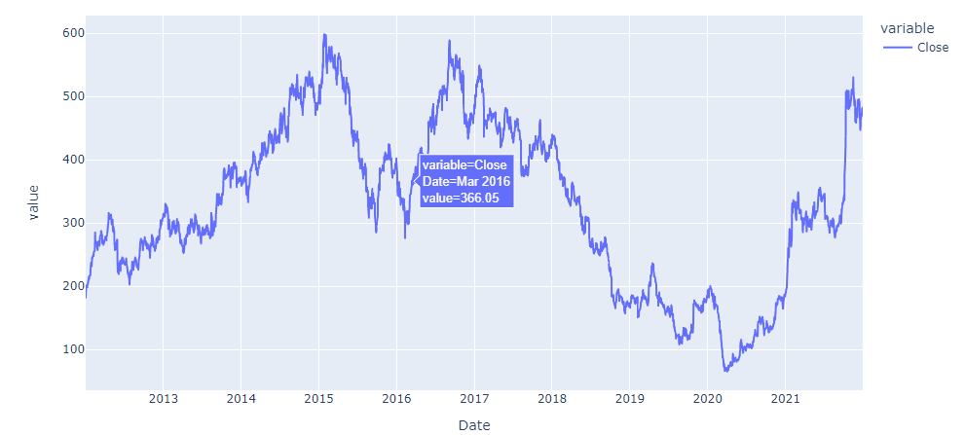
Libraries used
Plotted graph using PLOTLY for Close column.

Slide 6
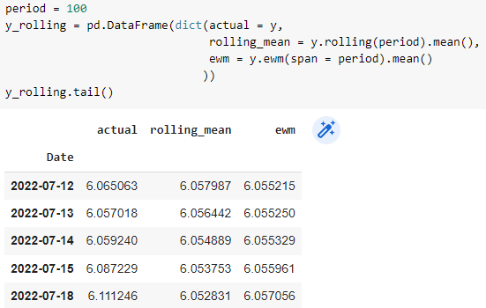
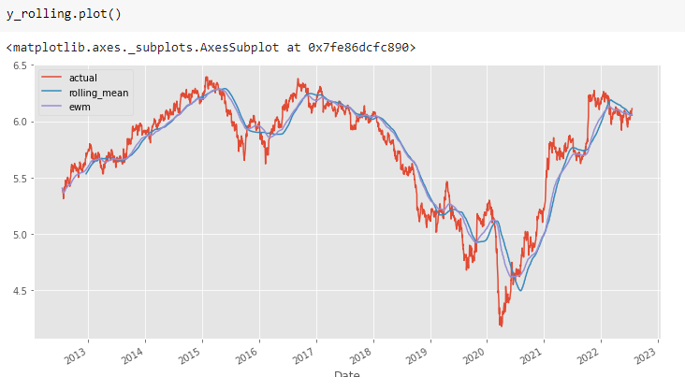
Calculate rolling mean, exponentially weighted mean
Plotting rolling mean,exponentially weighted mean

Slide 7
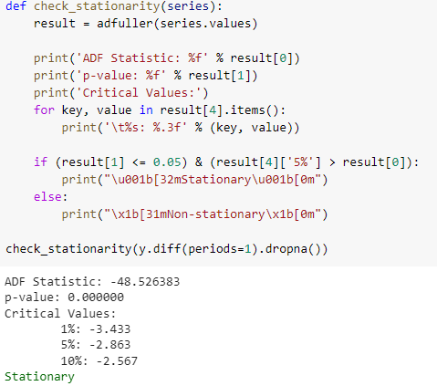
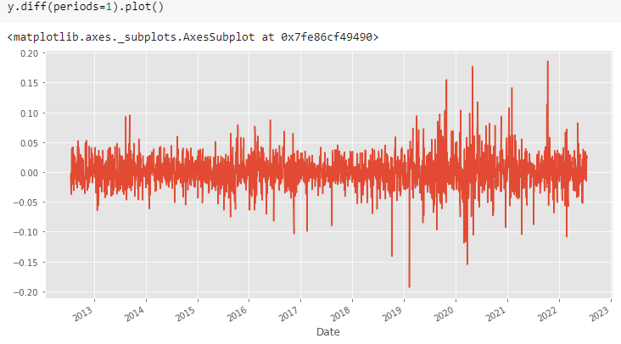
Performing Dickey Fuller test to check for Stationarity of data.
Data Seems to be stationarity for close column

Slide 8
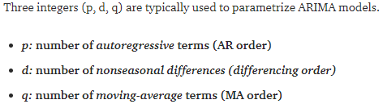
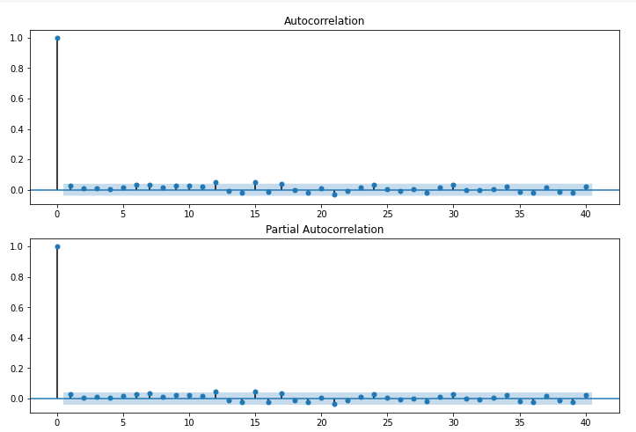
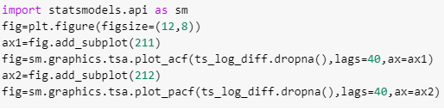
Building ARIMA Model
Building ARIMA Model:
Autocorrelation function (ACF), and Partial autocorrelation function (PACF) plots of the series are necessary to determine the order of AR and/ or MA terms.
Though ACF and PACF do not directly dictate the order of the ARMA model, the plots can facilitate understanding the order and provide an idea of which model can be a good fit for the time-series data.

Slide 9
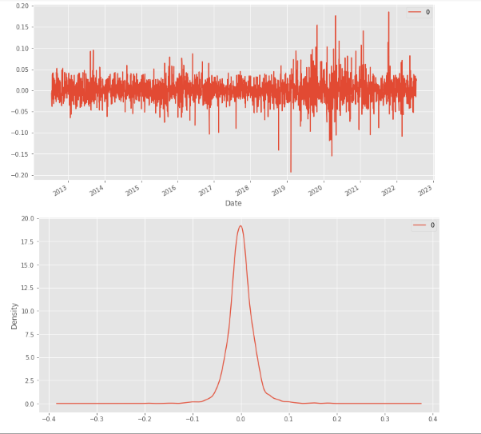
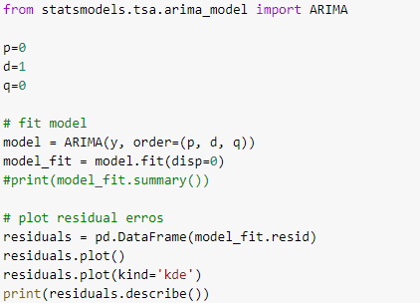

Slide 10
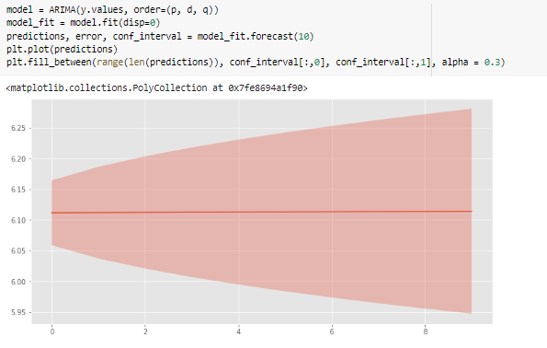
Building and Fitting model
Fitting Model

Slide 11
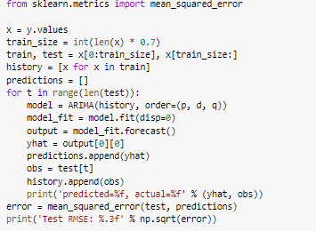
Calculating the mean squared error
Calculating the mean squared error

Slide 12

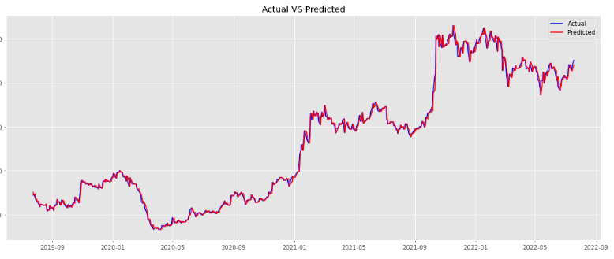
Predicting Actual and Predicted values

Slide 13
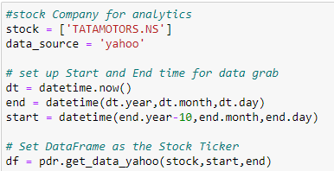
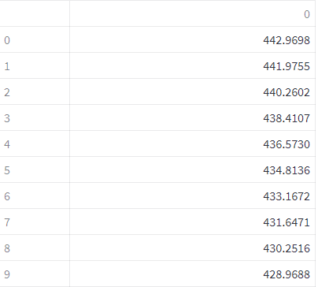
Forecasting data for next 10 days

Slide 14
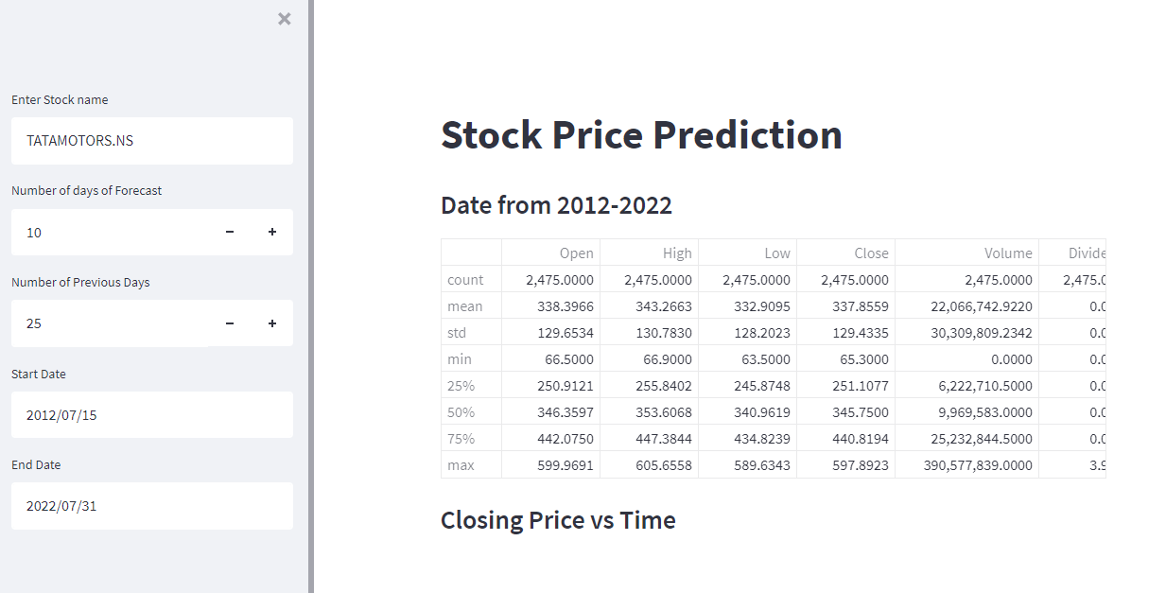
Deployment Preview in Streamlit

Slide 15
Project GitHub Links of Group Members :
Shubham Kapadane : https://github.com/Shubh2906/Stock-Market-Prediction
Rahul Patel : https://github.com/rahulpatel0890/Project_Stock_Prediction
Shreyansh Gaurkar : -
Pranali Jagtap : https://github.com/pranalijagtap21/Pranali-Jagtap
Mahesh Renkuntla : https://github.com/rmahesh6386/Tata-Motors-Project-

Slide 16
THANK YOU

